Slide 1



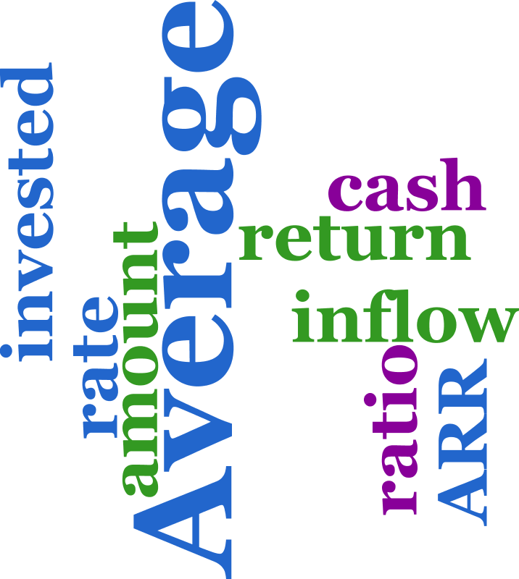
Rate of Return Method

Slide 2

After studying this chapter, you should
be able to understand:
What is Rate of Return Method
Numerical / Problems
L E A R N I N G O B J E C T I V E S

Slide 3
Introduction
The rate of return of a cash flow pattern is the interest rate at which the present worth of that cash flow pattern reduces to zero.
In this method of comparison, the rate of return for each alternative is computed.
Then the alternative which has the highest rate of return is selected as the best alternative.
Notes:
It is the amount of income generated in an year by capital invested.

Slide 4
Example: Rate of Return
Rate of Return:
It is the amount of income generated in an year by capital invested.
Vincent Gogh’s painting “Irises”
  John Whitney Payson bought the art at $80,000.
  John sold the art at $53.9 million in 40 years.
  What is the rate of return on John’s investment?

Slide 5
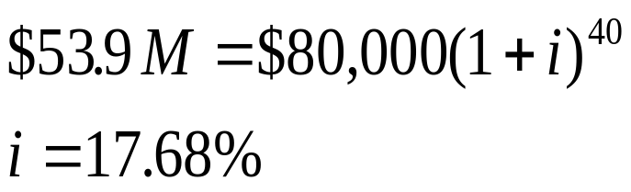
Rate of Return
Given: P =$80,000, F = $53.9M, and N = 40 years
Find: i
Solution:
$53.9M
0
40
$80,000

Slide 6
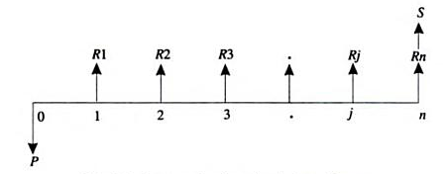
Rate of Return Method
  A generalized cash flow diagram to demonstrate the rate of return method of comparison is as follows.
    Where,
    P – Represents initial investment ; Rj – Net revenue at the end of j^{th} year ; S – Represent the salvage value at the end of n^{th} year

Slide 7
Rate of Return Method Steps
  1. The first step is to find the net present worth of the cash flow diagram using the following expression for a given interest rate, i:
  PW(i) = - P + R1 / (1+ i)¹ + R2 /(1+i)² + … + Rj/(1+i)^{j}
  + … + Rn/(1+i)^{n} + S/(1+i)^{n}
  2. The above function is to be evaluated for different values of i until the present worth function reduces to zero as shown in figure below
Positive
Present worth PW(i)
Rate of return
0
2
4
6
8
10
12
14
16
Negative
Interest rate (i%)
Present worth function graph

Slide 8
Rate of Return Method Steps
  In the figure, the present worth goes on decreasing when the interest rate is increased.
  The value of i at which the present worth curve cuts the X-axis is the rate of return of the given proposal/project.
  So, one has to start with an intuitive value of i and check whether the present worth function is positive. If so, increase the value of i until PW(i) becomes negative.
  Then the rate of return is determined by interpolation method in the range of values of i for which the sign of the present worth function changes from positive to negative

Slide 9
Solved Problems
A person is planning a new business. The initial outlay and cash flow pattern for the new business are as listed below. The expected life of the business is five years. Find the rate of return for the new business.
A company is trying to diversify its business in a new product line. The life of the project is 10 years with no salvage value at the end of its life. The initial outlay of the project is Rs 20,00,000. The annual net profit is Rs 3,50,000. Find the rate of return for the new business.
Period | 0 | 1 | 2 | 3 | 4 | 5
Cash flow (Rs) | - 1,00,000 | 30,000 | 30,000 | 30,000 | 30,000 | 30,000

Slide 10
Solved Problems
3. A firm has identified three mutually exclusive investment proposals whose details are given below. The life of all the three alternatives is estimated to be five years with negligible salvage value. The minimum attractive rate of return for the firm is 12%.
Find the best alternative based on the rate of return method of comparison.
 | Alternative
 | A1 | A2 | A3
Investment (Rs) | 1,50,000 | 2,10,000 | 2,55,000
Annual net income (Rs) | 45,570 | 58,260 | 69,000

Slide 11
Solved Problems
4. A company is planning to expand its present business activity. It has two alternatives for the expansion programme and the corresponding cash flows are tabulated below. Each alternative has a life of five years and a negligible salvage value. The minimum attractive rate of return for the company is 12%. Suggest the best alternative to the company.
 | Initial Investment (Rs) | Yearly revenue (Rs)
Alternative 1 | 5,00,000 | 1,70,000
Alternative 2 | 8,00,000 | 2,70,000

Slide 12
Solved Problems
1. Soln:
Given data: P= Rs. 1,00,000/- ; Annual equal revenue = Rs. 30,000/- ; n = 5 yrs
The CFD is shown below:
The present worth function for the business is,
PW(i) = - P + A (P/A, i , n)
When i=10%, PW(10%) = - 1,00,000 + 30,000 (P/A, 10% , 5)
= - 1,00,000 + 30,000 (3.7908)
= Rs 13,724/-
Rs. 30,000
Rs. 30,000
0
1
2
3
4
5
Rs. 1,00,000

Slide 13
Solved Problems
When i = 15% , PW(15%) = - 1,00,000 + 30,000 (P/A, 15% , 5)
= - 1,00,000 + 30,000 (3.3522)
= Rs 566/-
When i = 18% , PW(18%) = - 1,00,000 + 30,000 (P/A, 18% , 5)
= - 1,00,000 + 30,000 (3.1272)
= Rs – 6,184/-
i = 15% + (18% - 15%) * 566 – 0
566 – ( - 6,184)
= 15% + 0.252%
= 15.252%
Therefore, the rate of return for the new business is 15.252%

Slide 14
Solved Problems
Soln:
Given data: P = Rs. 20,00,000/- ; Annual net profit = Rs. 3,50,000/- ; Life = 10 yrs ; scrap value after 10 years = 0
S = Rs 15,000 ; i = 25% compounded annually
The CFD is shown below:
The present worth function for the business is,
PW(i) = - P + A (P/A, i , n)
When i=10%, PW(10%) = -20,00,000 + 3,50,000(P/A, 10%, 10)
= -20,00,000 + 3,50,000(6.1446) = Rs. 1,50,610/-
3,50,000
3,50,000
3,50,000
0
1
2
3
10
t
Rs.20,00,000

Slide 15
Solved Problems
When i=12%, PW(12%) = -20,00,000 + 3,50,000(P/A, 20%, 10)
= -20,00,000 + 3,50,000(5.6502)
= Rs. -22,430/-
i= 10% + 1,50,610 - 0 * (12%-10%)
1,50,610 – (-22,430)
i = 10 % + (0.8703 * 2%) = 10 % + 1. 74 %
i = 11.74%
Therefore, the rate of return of the new product line is 11.74%

Slide 16
Solved Problems
3. Soln: Calculation of rate of return for Alternative A1
Given data: Initial outlay P= Rs 1,50,000/- ; Annual profit =Rs 45,570/- n = 5 yrs
The CFD for Alternative A1:
The formula for the net present worth of alternative A1 is given as:
PW(i) = - P + A (P/A, i , n)
When i=10%, PW(10%) = - 1,50,000 + 45,570 (P/A, 10% , 5)
= - 1,50,000 + 45,570 (3.7908)
= Rs 22,746.76/-
Rs. 45,570
Rs. 45,570
0
1
2
3
4
5
Rs. 1,50,000

Slide 17
Solved Problems
When i=15%, PW(15%) = - 1,50,000 + 45,570 (P/A, 15% , 5)
= - 1,50,000 + 45,570 (3.3522)
= Rs 2,759.75/-
When i=18%, PW(10%) = - 1,50,000 + 45,570 (P/A, 18% , 5)
= - 1,50,000 + 45,570 (3.1272)
= Rs – 7,493.50/-
Therefore, the rate of return of the alternative A1 is
i= 15% + 2,759.75 - 0 * (3%)
2,759.75 – ( - 7493.50)
= 15% + 0.81%
= 15.81%

Slide 18
Solved Problems
Calculation of rate of return for Alternative A2
Given data: Initial outlay P= Rs 2,10,000/- ; Annual profit =Rs 58,260/- n = 5 yrs
The CFD for Alternative A1:
The formula for the net present worth of alternative A1 is given as:
PW(i) = - P + A (P/A, i , n)
When i=12%, PW(10%) = - 2,10,000 + 58,260 (P/A, 12% , 5)
= - 2,10,000 + 58,260 (3.6048)
= Rs 15.65/-
Rs. 58,260
Rs. 58,260
0
1
2
3
4
5
Rs. 2,10,000

Slide 19
Solved Problems
When i=13%, PW(13%) = - 2,10,000 + 58,260 (P/A, 13% , 5)
= - 2,10,000 + 58,260 (3.5172)
= Rs -5,087.93/-
Therefore, the rate of return of the alternative A2 is
i= 12% + 15.65 - 0 * (1%)
15.65 – ( - 5087.93)
= 12% + 0%
= 12%

Slide 20
Solved Problems
4. Soln: Alternative A1
Given data: Initial outlay P = Rs 5,00,000/-;
Annual revenue =Rs 1,70,000/- n = 5 yrs
The CFD for Alternative A1:
The formula for the net present worth of alternative A1 is given as:
PW(i) = - P + A (P/A, i , n)
When i=15%, PW(15%) = - 5,00,000 + 1,70,000 (P/A, 15% , 5)
= - 5,00,000 + 1,70,000 (3.3522)
= Rs 69,874/-
Rs. 1,70,000
Rs. 1,70,000
0
1
2
3
4
5
Rs. 5,00,000

Slide 21
Solved Problems
When i=20%, PW(20%) = - 5,00,000 + 1,70,000 (P/A, 20% , 5)
= - 5,00,000 + 1,70,000 (2.9906)
= Rs 8,402/-
When i=22%, PW(22%) = - 5,00,000 + 1,70,000 (P/A, 22% , 5)
= - 5,00,000 + 1,70,000 (2.8636)
= Rs -13,188/-
Therefore, the rate of return of the alternative 1 is
i= 20% + 8,402 - 0 * (2%)
8,402 – ( -13,188)
= 20% + 0.78%
= 20.78%

Slide 22
Solved Problems
4. Soln: Alternative A2
Given data: Initial outlay P = Rs 8,00,000/-;
Annual revenue =Rs 2,70,000/- n = 5 yrs
The CFD for Alternative A1:
The formula for the net present worth of alternative A1 is given as:
PW(i) = - P + A (P/A, i , n)
When i=20%, PW(20%) = - 8,00,000 + 2,70,000 (P/A, 20% , 5)
= - 8,00,000 + 2,70,000 (2.9906)
= Rs 7,462/-
Rs. 2,70,000
Rs. 2,70,000
0
1
2
3
4
5
Rs. 8,00,000

Slide 23
Solved Problems
When i=22%, PW(22%) = - 8,00,000 + 2,70,000 (P/A, 22% , 5)
= - 8,00,000 + 2,70,000 (2.8636)
= Rs – 26,828/-
Therefore, the rate of return of the alternative 1 is
i= 20% + 7,462 - 0 * (2%)
7,462 – ( -26828)
= 20.435%
Since the rate of return of alternative 1 is greater than that of the alternative 2. select alternative 1.

Slide 24
Types of Rate of Return
Following rate of returns are frequently used,
The minimum acceptable rate of return (MARR)
Lowest level of return at which the investment is acceptable.
The limit is set by individuals or organizations.
It ensures the best possible use of limited resources.

Slide 25
Types of Rate of Return
The Internal Rate of Return (IRR)
It is the rate on the unrecovered balance of the investment where the terminal balance is zero.
Notes:
IRR-the project break-even interest rate

Slide 26
IRR Misconcepts
Ranking alternatives by individual IRR
Ranking alternatives by individual IRR values can give conflicting results when ranking is done based on PW method.
This is evident from the following example

Slide 27
Why Must Incremental Analysis be Used for Competing Projects?
Assume that an MARR of 16% per year is required, and $90000 is available to invest:
Project A requires $50000 upfront to obtain an IRR of 35% per year.
Project B requires an $85000 first cost and returns an IRR of 29% per year.
What could we do with the un-invested money from Project A? ($40000)

Slide 28
Why Must Incremental Analysis be Used for Competing Projects?
It would be reasonable to invest the remaining $40000 at the MARR:
Overall IRR_{A} = 50000(0.35) + 40000(0.16)
90000
= 26.6% per year
Project B returns an IRR of 28.3% per year on ALL the money available to invest.

Slide 29
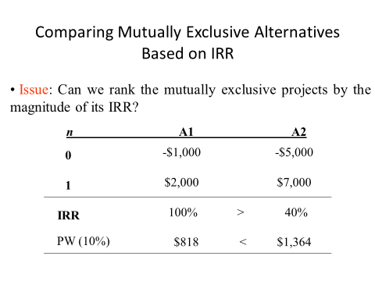

Notes:
If you decide to invest in option A1, you will need to withdraw only $1,000 from your investment pool. The remaining $4,000 will continue to earn 10% interest. One year later, you will have $2,000 from the outside investment and $4,400 from the investment pool. With an investment of $5,000,in one year you will have $6,400. The equivalent present worth of this change in wealth is PW = -5000 + 6400(p/f,i,1) = 818.

Slide 30
Incremental Analysis (Procedure)
Step 1: Compute the cash flow for the difference between the
projects (A,B) by subtracting the cash flow of the lower
investment cost project (A) from that of the higher investment cost project (B).
Step 2: Compute the IRR on this incremental investment (IRR)
Step 3: Accept the investment B if and only if
IRR _{B-A} > MARR
NOTE: Make sure that both IRR_{A} and IRR_{B} are greater than MARR

Slide 31
Solved Problems
5. John Covington, a college student, wants to start a small-scale painting business during his off-school hours. To economize the start-up business, he decides to purchase some used painting equipment. He has two mutually exclusive options: Do most of the painting by himself by limiting his business to only residential painting jobs (B1) or purchase more painting equipment and hire some helpers to do both residential and commercial painting jobs that he expects will have a higher equipment cost, but provide higher revenues as well (B2). In either case, John expects to fold up the business in three years, when he graduates from college. The cash flows for the two mutually exclusive alternatives are as follows:
n | B1 | B2
0 | -$ 3,000 | -$ 12,000
1 | 1,350 | 4,200
2 | 1,800 | 6,225
3 | 1,500 | 6,330
IRR | 25% | 17.43%

Slide 32
Solved Problems
Knowing that both alternatives are revenue projects, which project would John select at MARR = 10% (Note that both projects are also profitable at 10%.)
6. Consider the following two mutually exclusive investment projects that require the same amount of investment: Which project would you select on the basis of the rate of return on incremental investment, assuming that MARR = 12%(Once again, both projects are profitable at 12%.)
n | C1 | C2
0 | -$ 9,000 | -$ 9,000
1 | 480 | 5,800
2 | 3,700 | 3,250
3 | 6,550 | 2,000
4 | 3,780 | 1,561
IRR | 25% | 17.43%

Slide 33
Solved Problems
7. Consider the following three sets of mutually exclusive alternatives:
Which project would you select on the basis of the rate of return on
incremental investment, assuming that MARR=15%?
n | D1 | D2 | D3
0 | -$ 2,000 | -$ 1,000 | -$ 3,000
1 | 1,500 | 800 | 1,500
2 | 1,000 | 500 | 2,000
3 | 800 | 500 | 1,000
IRR | 34.37% | 40.76% | 24.81%
Notes:
P.W = -1000+700(P/F,I,1)+500(P/F,I,2)+300(P/F,I,3) …….(D1-D2)
=+Ve…… D1 is better than D2
PW = -1000+1000(P/F,I,2)+200(P/F,I,3) ………..(D3-D1)
= -Ve …... D1 is better than D3

Slide 34
Solved Problems
8. Incremental IRR – Unequal life. MARR = 10%
n | E1 | E2
0 | -$ 2,000 | -$ 3,000
1 | 1,000 | 4,000
2 | 1,000
3 | 1,000
n | E1 | E2 | E2-E1
0 | -$ 2,000 | -$ 3,000 | - $ 1000
1 | 1,000 | 4,000 - 3000 | 0
2 | 1,000 | 4,000 – 3000 | 0
3 | 1,000 | 4000 | 3000
Notes:
PW= -1000+3000(P/F,10,3) = 1253.94(+ve), E2>E1

Slide 35
Solved Problems
5. Soln:
The CFD for B2-B1 is shown below:
The present worth function is,
PW(i) = - P + A1(P/F, i , 1) + A2(P/F,i,2) + A3(P/F,i,3)
n | B1 | B2 | B2-B1
0 | -$ 3,000 | -$ 12,000 | -$ 9,000
1 | 1,350 | 4,200 | 2,850
2 | 1,800 | 6,225 | 4,425
3 | 1,500 | 6,330 | 4,830
IRR | 25% | 17.43%
$ 2850
$ 4,425
$ 4,830
0
1
2
3
$ 9,000

Slide 36
Solved Problems
When i=10%, PW(10%) = - P + A1(P/F, i , 1) + A2(P/F,i,2) + A3(P/F,i,3)
= - 9,000 + 2850(P/F,10%,1) + 4425(P/F,10%,2)
+ 4830(P/F,10%,3)
= - 9,000 + 2850(0.9091) + 4425(0.8264)
+ 4830(0.7513)
= - 9000 + 2590.93 + 3656.82 + 3628.77
= 876.52
When i=12%, PW(12%) = - 9,000 + 2850(P/F,12%,1) + 4425(P/F,12%,2)
+ 4830(P/F,12%,3)
= - 9,000 + 2850(0.8929) + 4425(0.7972)
+ 4830(0.7118)
= - 9000 + 2544.76 + 3527.61 + 3437.99
= 510.36

Slide 37
Solved Problems
When i=15%, PW(15%) = - P + A1(P/F, i , 1) + A2(P/F,i,2) + A3(P/F,i,3)
= - 9,000 + 2850(P/F,15%,1) + 4425(P/F,15%,2)
+ 4830(P/F,15%,3)
= - 9,000 + 2850(0.8696) + 4425(0.7561)
+ 4830(0.6575)
= - 9000 + 2478.36 + 3345.74 + 3175.72
= -0.18
Therefore, the rate of return of the alternative B2-B1 is
i_{B2-B1} = 12% + 510.36 - 0 * (15% - 12%)
510.36 – ( - 0.18)
= 12% + 2.99%
i_{B2-B1} = 14.99% = 15%
Interpretation: Since i_{B2-B1} > MARR (10%), select B2 alternative.

Slide 38
Solved Problems
6. Soln:
The CFD for C1-C2 is shown below:
The present worth function is,
PW(i) = - P + A1(P/F, i , 1) + A2(P/F,i,2) + A3(P/F,i,3)
n | C1 | C2 | C1- C2
0 | -$ 9,000 | -$ 9,000 | 0
1 | 480 | 5,800 | -5,320
2 | 3,700 | 3,250 | 450
3 | 6,550 | 2,000 | 4,550
4 | 3,780 | 1,561 | 2,219
IRR | 25% | 17.43%
450
4,550
2,219
0
1
2
3
$ 5,320

Slide 39
Solved Problems
When i=10%, PW(10%) = - P + A1(P/F, i , 1) + A2(P/F,i,2) + A3(P/F,i,3)
= - 5,320 + 450(P/F,10%,1) + 4,550(P/F,10%,2)
+ 2,219(P/F,10%,3)
= - 5,320 + 450(0.9091) + 4550(0.8264)
+ 2219(0.7513)
= - 5,320 + 409.09 + 3760.12 + 1667.13
= 516.34
When i=12%, PW(12%) = - 5,320 + 450(P/F,12%,1) + 4550(P/F,12%,2)
+ 2219(P/F,12%,3)
= - 5,320 + 450(0.8929) + 4550(0.7972)
+ 2219(0.7118)
= - 5320 + 401.8 + 3627.26 + 1579.48
= 288.54

Slide 40
Solved Problems
When i=15%, PW(15%) = - P + A1(P/F, i , 1) + A2(P/F,i,2) + A3(P/F,i,3)
= - 5,320 + 450(P/F,15%,1) + 4550 (P/F,15%,2)
+ 2219(P/F,15%,3)
= - 5,320 + 450(0.8696) + 4550(0.7561)
+ 2219(0.6575)
= - 5320 + 391.32 + 3440.25 + 1458.99
= - 29.44
Therefore, the rate of return of the alternative B2-B1 is
i_{C1-C2} = 12% + 288.54 - 0 * (15% - 12%)
288.54 – ( - 29.44)
= 12% + 2.72%
i_{C1-C2} = 14.72%
Interpretation: Since IRR_{C1-C2} > MARR (12%), select C1 alternative.

Slide 41


Recap
What is Rate of return method
Numerical / Problems

